Slide 1
ECE 3130 – Digital Electronics and Design
Lab 7
Shift Register
Fall 2016

Slide 2
Introduction
A shift register is a cascade of flip-flops that allows the bit-wise movement of the data contained within it.
Today we will…
Design a bidirectional(shift right & shift left), parallel-load shift register using DFFs.
Implement a clear control to reset the register to 0.

Slide 3
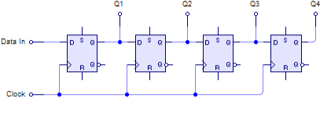
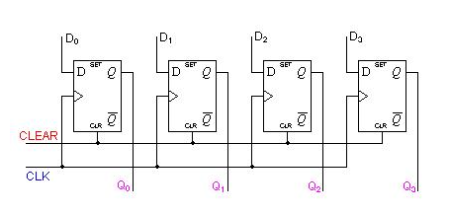
Shift-register
SIPO - Serial In, Parallel Out
PIPO – Parallel In, Parallel Out

Slide 4
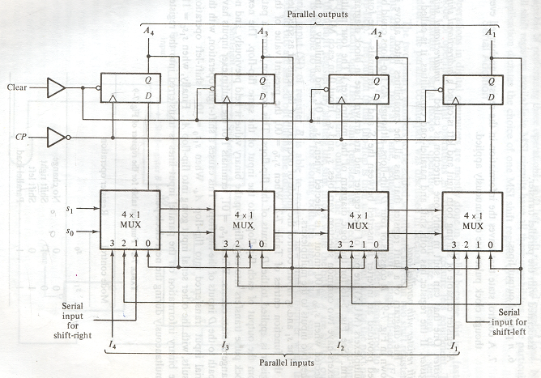
Schematic Design
DFF with clear pin
Buffer

Slide 5
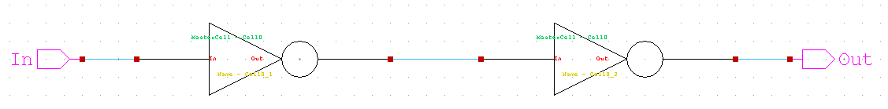
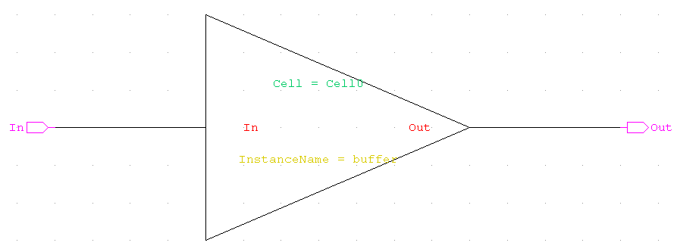
BUFFER

Slide 6
Function table for the register
Mode control |  | Register Operation
S1 | S0
0 | 0 | No change
0 | 1 | Shift Right
1 | 0 | Shift Left
1 | 1 | Parallel Load

Slide 7
In Mode#1:
Input S0=0, S1=0. Other input pins are not used.
The outputs O1-O4 will not change in this mode.
In Mode#2 (SIPO):
Input S0=1, S1=0. “shift_right” pin is used to provide serial 1-bit input data.
Other input pins are not used.
In Mode#3 (SIPO):
Input S0=0, S1=1. “shift_left” pin is used to provide serial 1-bit input data.
Other input pins are not used.
In Mode#4 (PIPO):
Input S0=1, S1=1. I1,I2,I3,I4 are used to provide parallel 4-bit input data.
Other input pins are not used.
The outputs O1-O4 will be loaded to same value as inputs I1-I4.
For all modes(Mode#1-4):
Input “clk” pin is used to provide clock signal to DFFs.
Input “clear” pin is used to reset all DFFs’ outputs to 0.

Slide 8
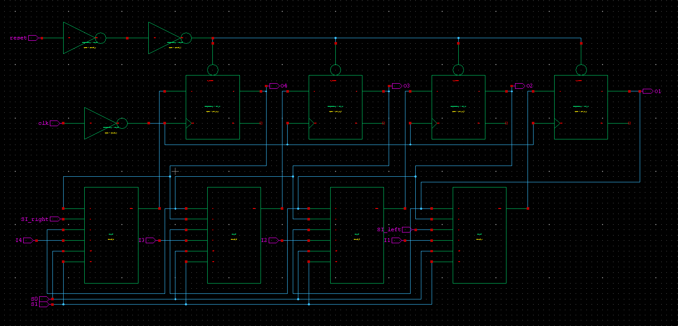
Shift Register

Slide 9
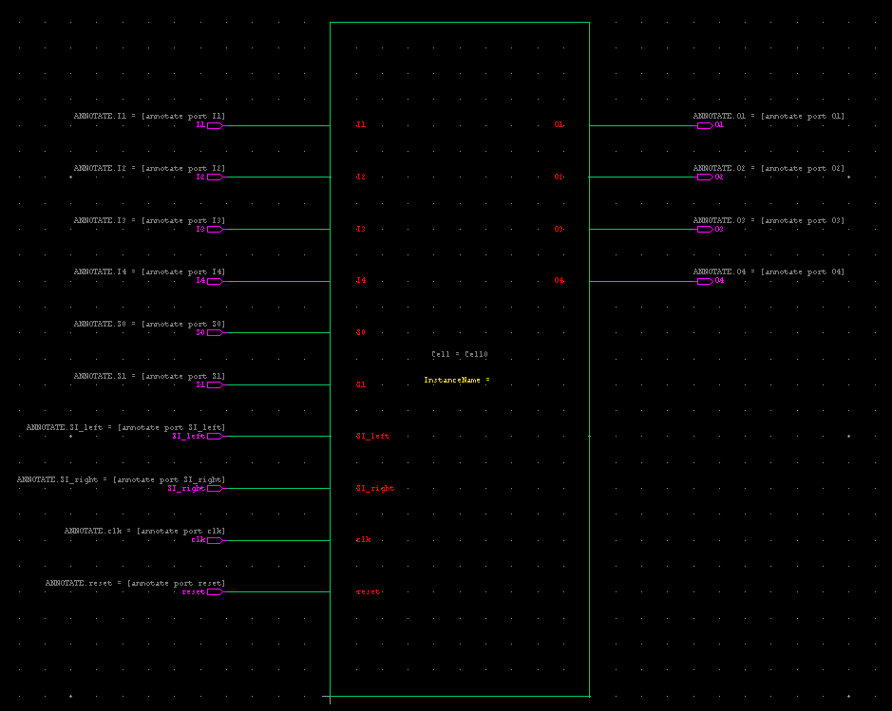
Symbol of Shift Register

Slide 10
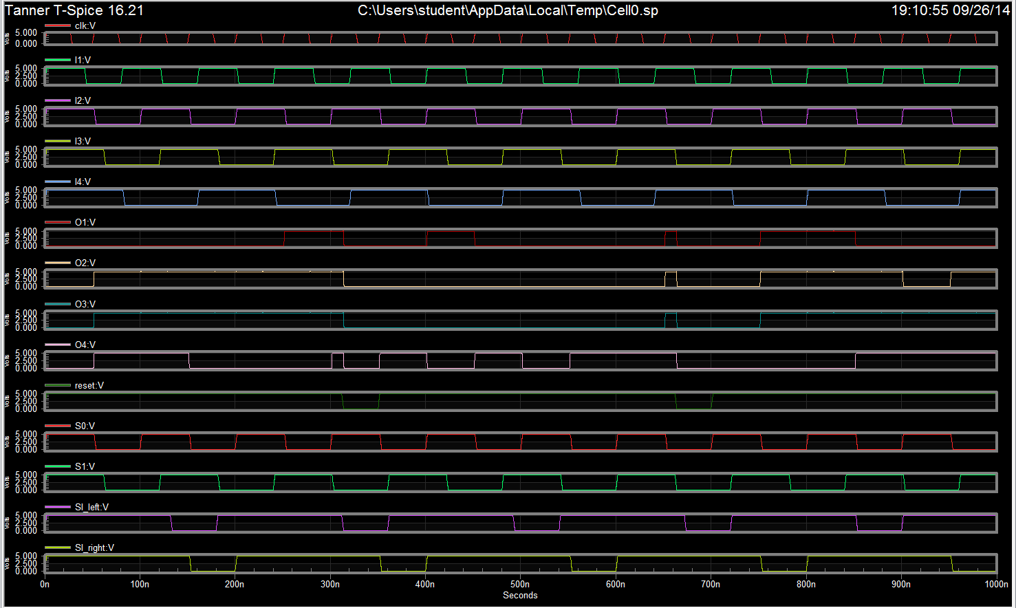

Slide 11
Assignment
Build and test a Shift Register that has 4 different modes.
Attach all screenshots into one PDF file, including schematic, symbol, test circuit schematic, waveforms.

